Slide 1
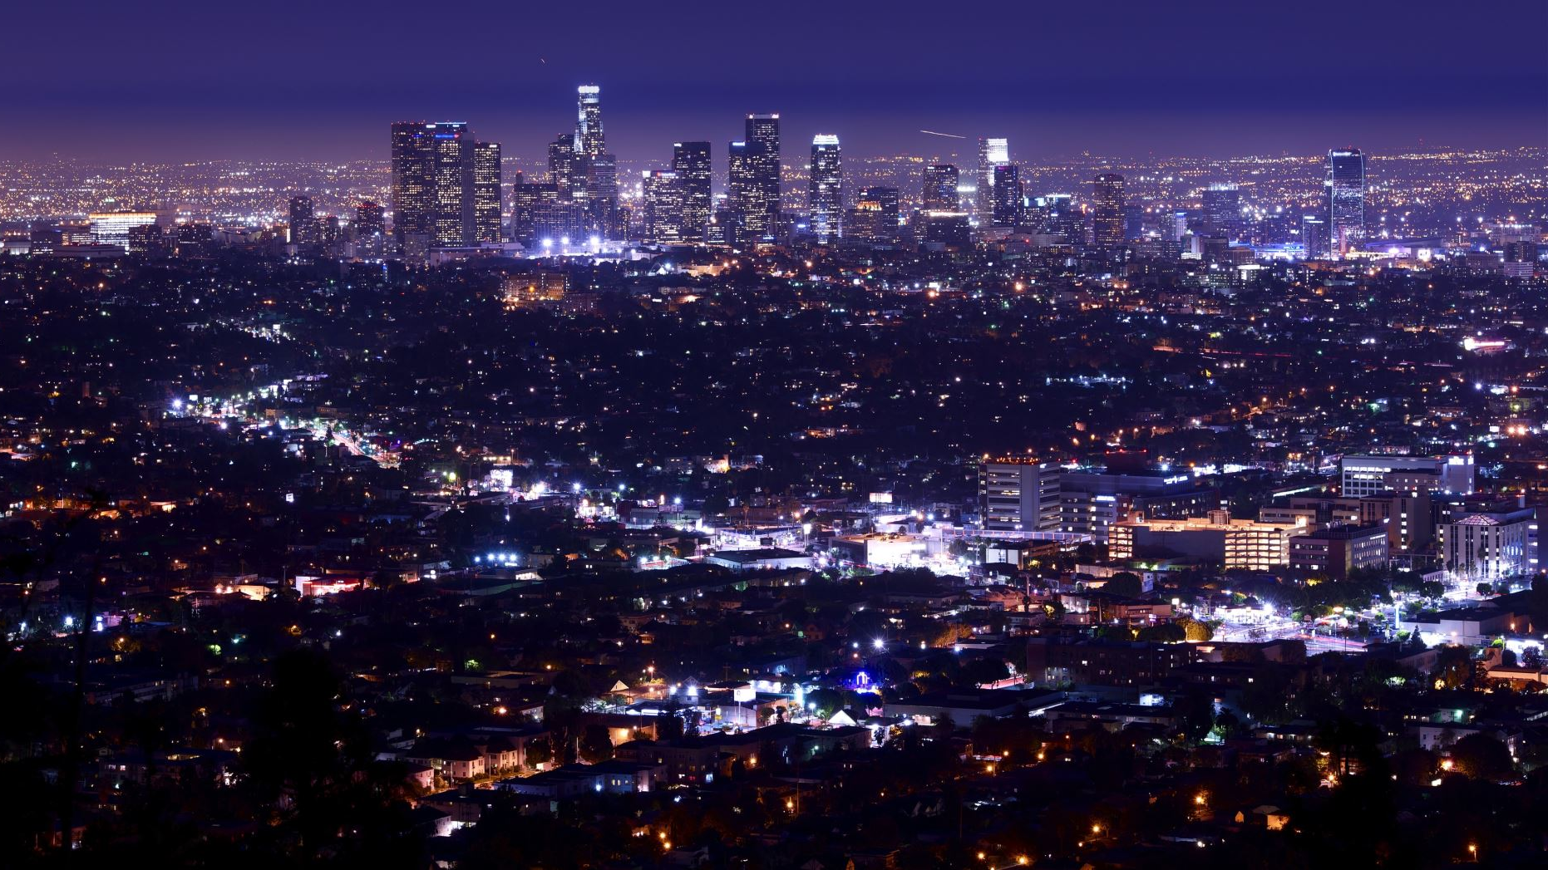
Los Angeles Thefts 2022 “Theft of Identity”
Mantas Vilius

Slide 2
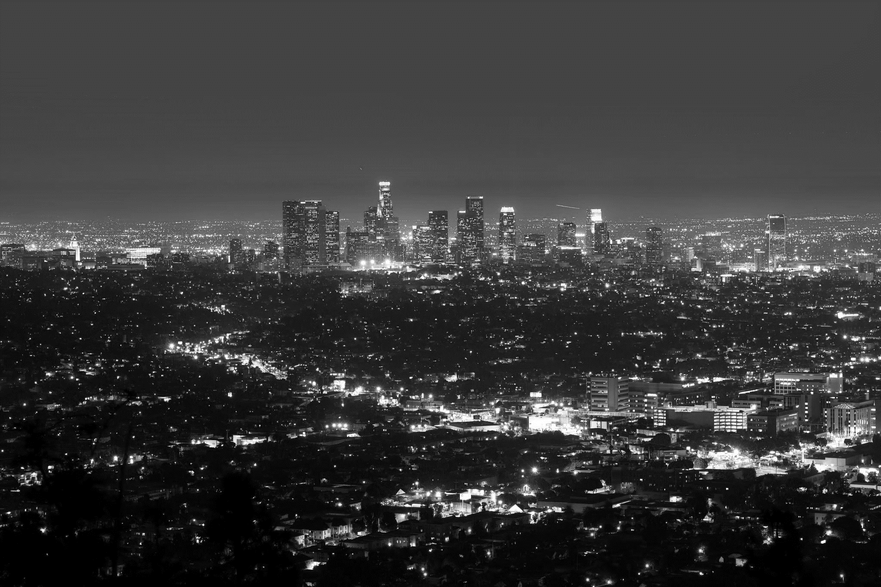
Agenda
Data Overview
Introduction
Crimes
Victims
Time
Location
Conclusion
Recommendations

Slide 3
Data Source
Data is from Kaggle which took a snapshot of whole data.
The original source is Los Angeles city’s open data portal
Notes:
Data is very technical and requires some knowledges like crime description and their hierarchy.

Slide 4
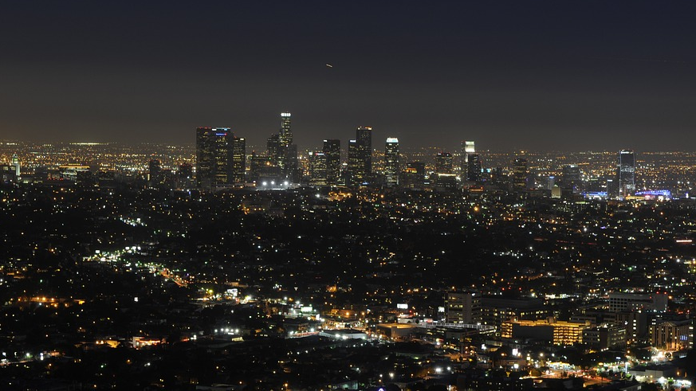
Introduction
This report analyses Los Angeles (L.A.) crime numbers provided by the Los Angeles police department. “The report is part of a Uniform Crime Reporting (UCR) Program to help agency staff formulate policies and make strategic and operational decisions”. The report shows the distribution of crimes committed based on victims' gender, descent, and age. Furthermore, reports show a time trend of crime occurrence and spatial data to display the city’s crime heatmap.
Notes:
The quote is taken from official report provided in attachments of data

Slide 5
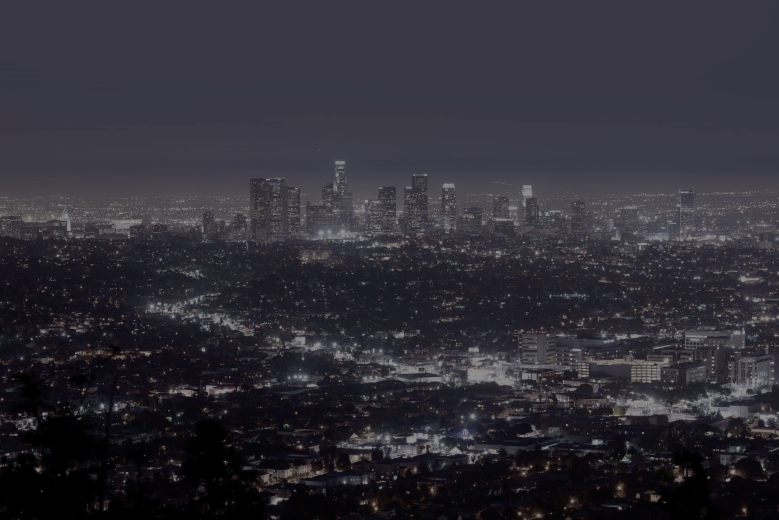
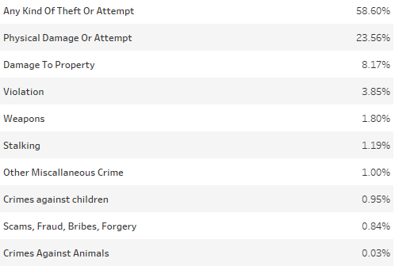
Crimes
In 2022 L.A.’s Police Department reported 234 921 crimes. Which is a 12.86% increase from the last year.
There were 133 unique crimes reported during 2022 which are grouped in groups based on their nature with a Theft or Attempt of making up 58.60% of all crimes.
Year | Crimes reported
2021 | 208 190
2022 | 234 921
Notes:
This section will cover mainly theft and the reason why report is focused on theft in particular
Crimes are sectioned in to 3 parts (Victims, Time, Location)

Slide 6
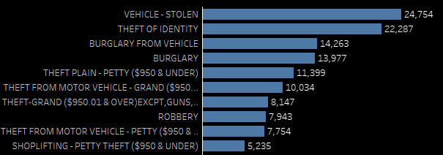
Crimes – “Any kind of theft of attempt of it”
Given that theft are more than half of the crimes it is a good place to delve deeper.

Slide 7
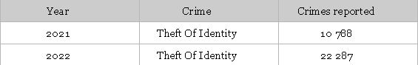
Crimes - “Theft of Identity”
Most notable increase in theft was reported for Theft of Identity crime.
The increase of 106%.
Notes:
The increase of 106.34% is very concerning. Theft of Identity itself is a unique crime in that committing Identity Theft is linked with other crimes, meaning that Theft of identity could be considered a method to commit another crime.
Due to this massive increase this crime is our focus.

Slide 8
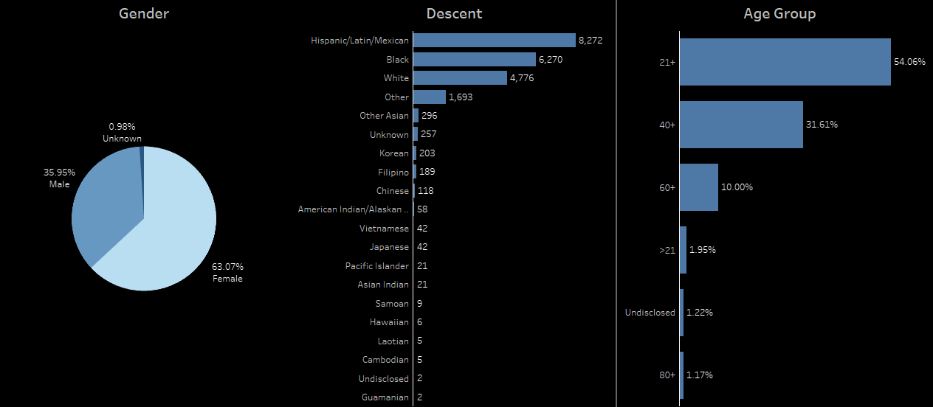
Victims – “Theft of Identity”
Descent is hard to define since L.A. is historically a very diverse city and given that a lot of victims haven’t disclose their ethnicity.
As for the distribution by gender more than half of the victims are Females.
Notes:
First glimpse at aggregated not only shows distribution between groups but also minimal number of Unknown/Undisclosed categories suggest health and accuracy of data

Slide 9
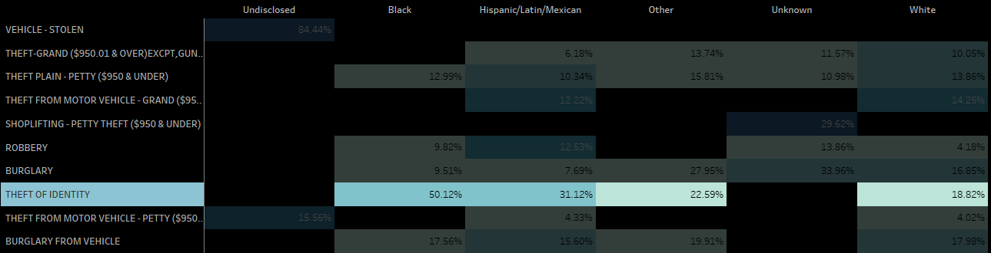
Victims (Descent Cohort)
Theft of Identity is always reported and does not have an undisclosed or unknown descent description and in context to all thefts covers all descent cohorts.
Notes:
identity theft half of the time is being reported by people of black descent.
Side note, to make a point that Vehicle – Stolen has no descriptive data

Slide 10
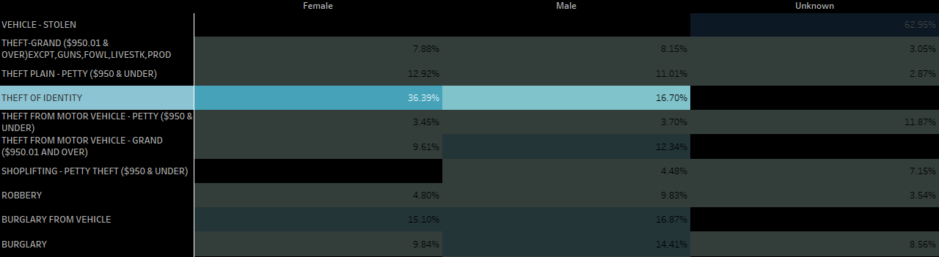
Victims (Gender Cohort)
Gender Cohort same as descent shows our focus crime to be a well-defined, gender split within the cohort with Female victims being two times larger than the Male cohort.
Notes:
Female victims that report any kind of theft more than a third of the time report Theft of Identity crime.
Side note, to make a point that Vehicle – Stolen has no descriptive data again

Slide 11
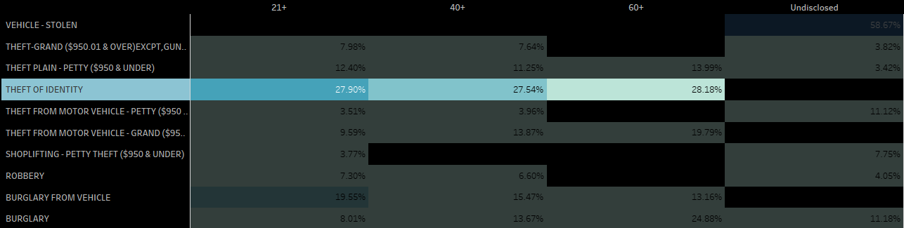
Victims (Age Cohort)
Age Cohort same as previous ones show that most prominent theft also has no link to person identifying characteristics.
Theft of identity has one third share of all thefts between adults.
Notes:
All age groups that report any kind of theft report identity theft close to third. And this crime makes up 17.96% of all crimes between all adult groups.

Slide 12
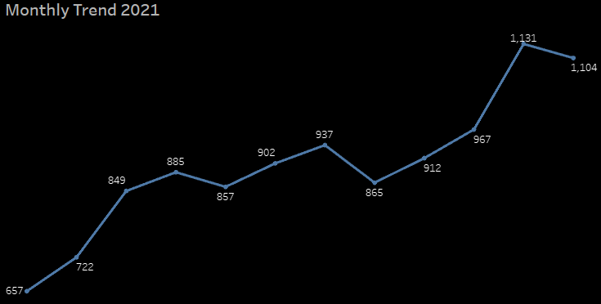
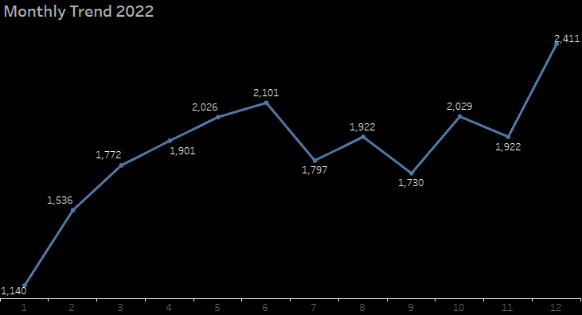
Time
Monthly trend shows that first half of the year is where the report is increasing.
The numbers show that the upward trend from 2021 is continued in 2022.
Notes:
In order to look if there is a seasonal pattern for time data we have to use at least 2 whole years.
first 6 months of both years identity theft increases and dips at middle-to-end of summer and continues to trend upwards.

Slide 13
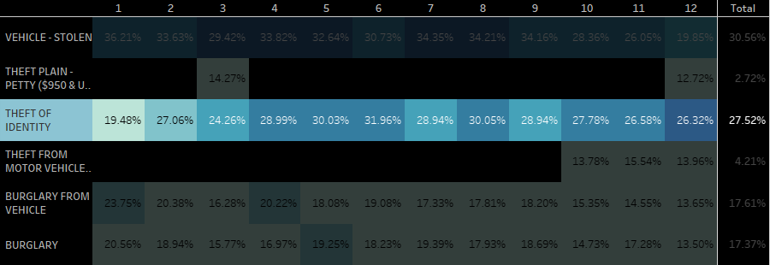
Time (Monthly Cohort)
We can see that some of the crimes are linked to a specific month.
Identity Theft is consistent throughout all months and in total makes almost one third of thefts.
Notes:
Looking at monthly cohorts to find time patterns we can see that Theft of Identity is one of the consistent crimes because it is being reported every month

Slide 14
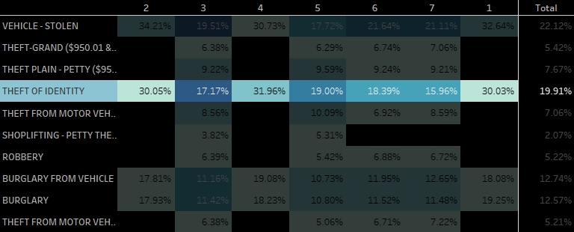
Time (Weekday Cohort)
We can see same trend as in monthly cohort.
Theft of Identity is consistent throughout all the days and is takes up largest (out of well-defined thefts) share most of the time.
Notes:
Theft of Identity continues to be consistent as it was in the monthly cohort and makes up close to 20% of all thefts that are being reported any given day

Slide 15
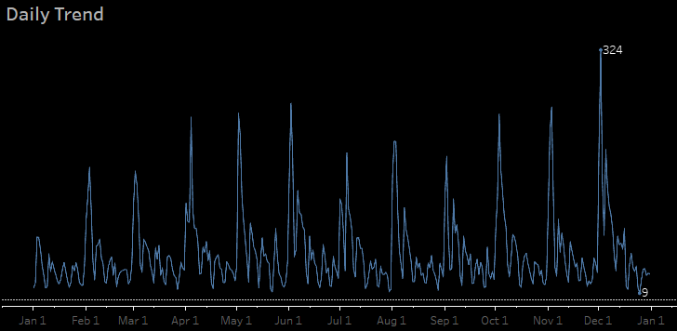
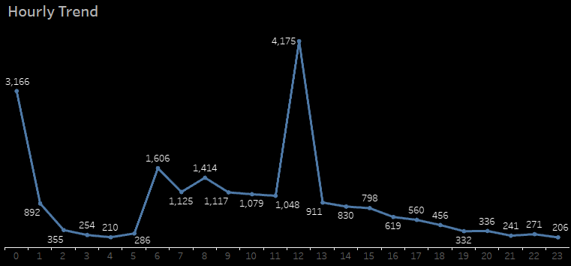
Time
Daily trend shows no pattern of seasonality.
Hourly trend suggests that most of the thefts are done in broad daylight, but actually data is skewed due to Theft of Identity reporting practise.
Notes:
0 and 12 are default crime times designed to keep data consistent.

Slide 16
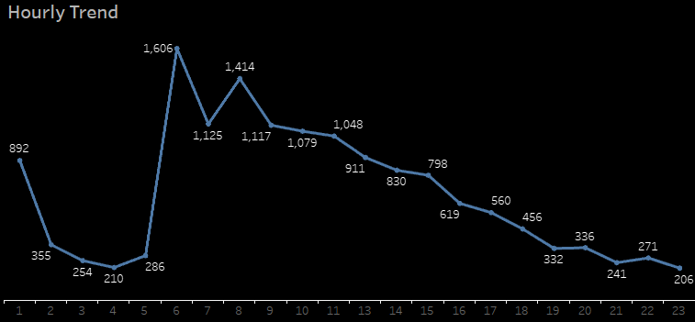
Time
Excluded default times shows downward trend.
Most occurrences are reported from early morning and slows down during working hours.
Notes:
Keeping in mind that this crime occur during workdays hourly data might suggest identity theft occurs during working hours.

Slide 17
Identity Theft
“Identity theft and identity fraud are terms used to refer to all types of crime in which someone wrongfully obtains and uses another person's personal data in some way that involves fraud or deception, typically for economic gain.”
Notes:
For the most part as seen with this crimes reporting it is hard to pinpoint exact location where this specific crime occurred and given that this crime can be a tool to commit another crime we are going to look at specific location.

Slide 18
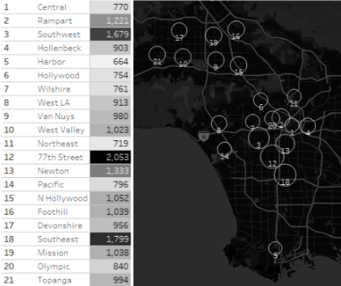
Location - Districts
There are 21 districts.
Looking at the numbers we can see that 77th Street, Southeast, and Southwest (represented by numbers 12, 18, and 3 respectively) are the top 3 districts where Theft of Identity occurred in 2022
Notes:
Looking at the map we can identify that all of these 3 districts are actually next to each other.
To see if the numbers correlate with districts and have significance in locating the most common crime districts we are going to use the results of linear regression

Slide 19
Location – Districts correlation
Looking at the results of linear regression we can see that 77th Street, Southeast, and Foothill have highest coefficients and associated hight t-ratio values.
These three areas could be our focus location.
 | Coefficient | Std. Error | t-ratio | p-value
const | 0,0684476 | 0,00276370 | 24,77 | <0,0001
77thStreet | 0,0720246 | 0,00366721 | 19,64 | <0,0001
Central | −0,0249324 | 0,00352663 | −7,070 | <0,0001
Devonshire | 0,0316152 | 0,00406527 | 7,777 | <0,0001
Foothill | 0,0636903 | 0,00429394 | 14,83 | <0,0001
Harbor | 0,00401145 | 0,00411325 | 0,9753 | 0,3294
Hollenbeck | 0,0376130 | 0,00419668 | 8,963 | <0,0001
Hollywood | −0,00840615 | 0,00379476 | −2,215 | 0,0267
Mission | 0,0438779 | 0,00410213 | 10,70 | <0,0001
N Hollywood | 0,0259615 | 0,00390627 | 6,646 | <0,0001
Newton | 0,0427286 | 0,00383952 | 11,13 | <0,0001
Northeast | 0,00201367 | 0,00399645 | 0,5039 | 0,6144
Olympic | 0,000731197 | 0,00382622 | 0,1911 | 0,8484
Pacific | −0,00761920 | 0,00375864 | −2,027 | 0,0427
Rampart | 0,0402094 | 0,00389887 | 10,31 | <0,0001
Southeast | 0,0847693 | 0,00385674 | 21,98 | <0,0001
Southwest | 0,0569539 | 0,00373905 | 15,23 | <0,0001
Topanga | 0,0365155 | 0,00407495 | 8,961 | <0,0001
VanNuys | 0,0335933 | 0,00405957 | 8,275 | <0,0001
WestLA | 0,0185545 | 0,00396613 | 4,678 | <0,0001
WestValley | 0,0308054 | 0,00398460 | 7,731 | <0,0001
Notes:
Next we are going to narrow down even futher and talk about premises where theft of identity occurred the most.

Slide 20
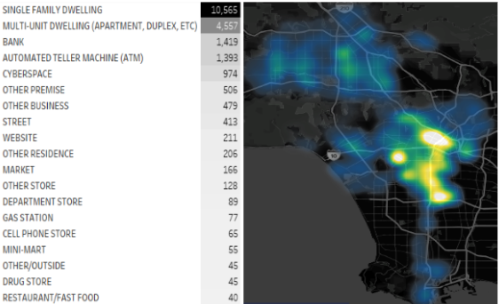
Location - Premises
Looking at the map most thefts that are reported are concentrated around the Central District and spreads south.
Notes:
Once again for numbers and their correlation with places we need statistical confirmation for that we ara going to use Logistic regression since its good for build classification model.

Slide 21
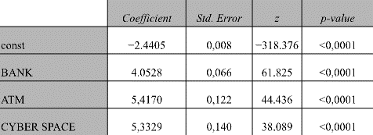
Location - Classification
Overall model’s Accuracy was 92%
Non-descriptive values were excluded since, single family homes, apartments and other business/premise can describe everything but nothing specific.
Notes:
We are omitting less descriptive locations in order to target well defined location.

Slide 22
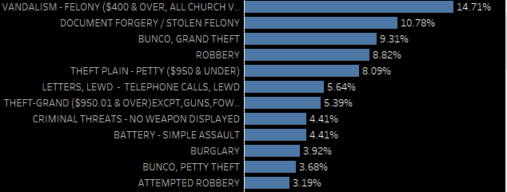
Location – Other crimes
The crimes associated with places (Bank, ATMs, Cyberspace)
Looking at all crimes (excluding Theft of Identity) we are introduced to new crimes but overall, it is related to Theft.
Notes:
Note that Bunco could mean a squad dealing with fraud or in street slang it means to cheat someone by selling false goods

Slide 23
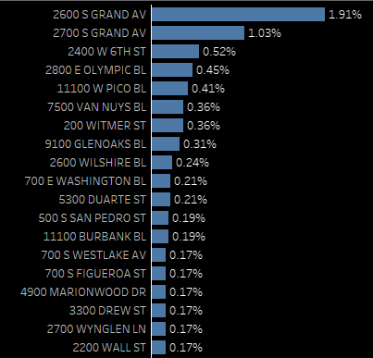
Location – Exact place
The crimes associated with places (Bank, ATMs, Cyberspace).
Top 2 streets are in Newton District.
Notes:
There are around 42K streets in LA metropolitan area that being said almost 3% is quite high.

Slide 24
Conclusion
Overall crime numbers have increased in 2022. Looking at thefts, in terms of crimes, this is a major issue.
Theft of Identity has massive increase in 2022.
Theft of Identity can lead to other crimes.
77th Street district had most reports for stolen identity while Newton district had most crimes related to stolen identity and given that they close to each other that could be another point of investigation.

Slide 25
Recommendations
Allocate recourses to the most prominent crime areas (districts, streets).
Inform Banks to tighten up their identity check policies.
Build residents’ awareness through public announcements, city billboards or social media.
Investigate what is specific about the 2 streets and the district itself.
Investigate if there is a link between 77th Street and Newton district to commit a crime using a stolen identity.
Refine data collection procedures to avoid terms Unknown/Other/Undisclosed in your data.
Use more sophisticated prediction models to find links between locations and crime.
Perform a deeper analysis using the provided dashboard to investigate other crimes and what is specific to them and perform data-driven decisions.

Slide 26
Thank you

